Slide 1
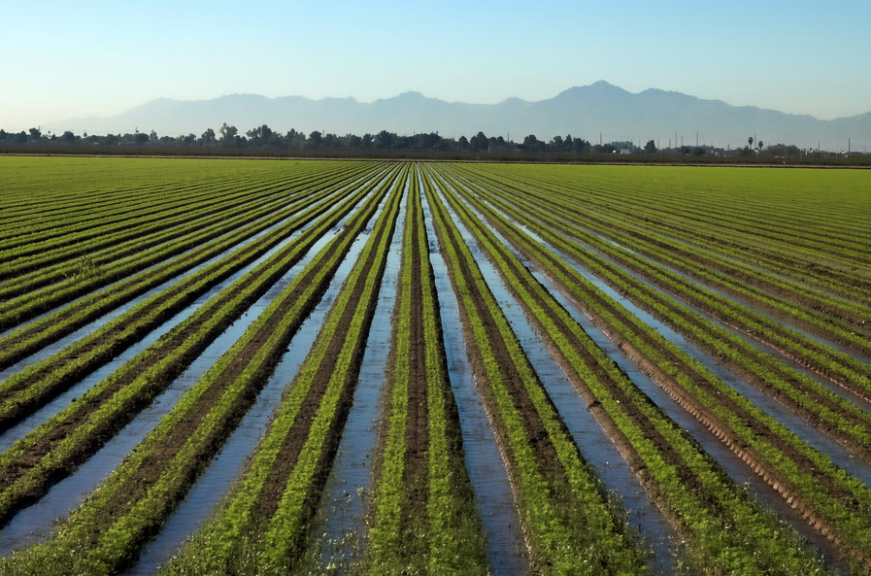


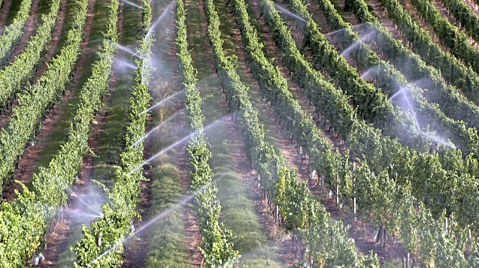
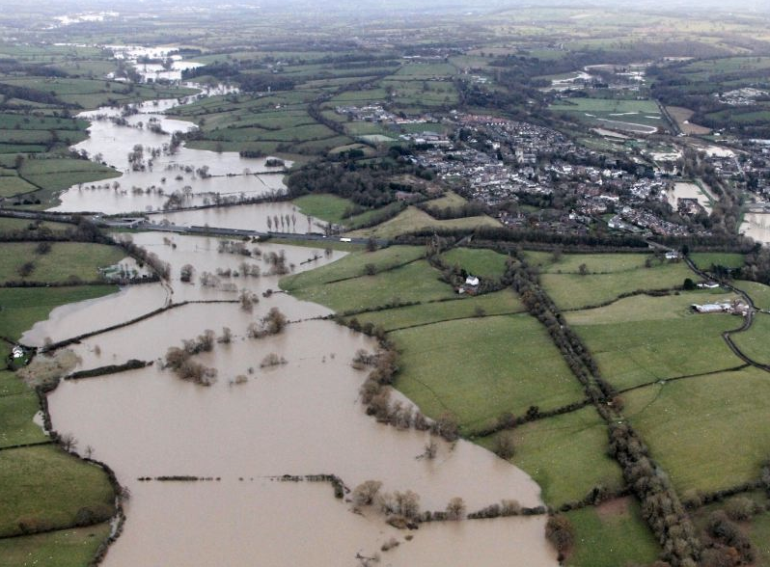
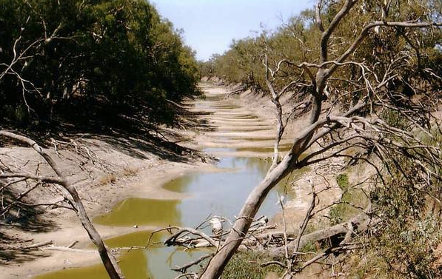
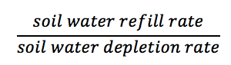
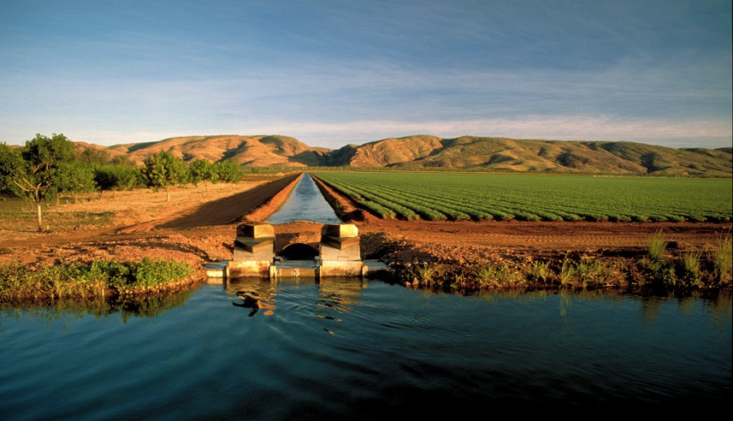
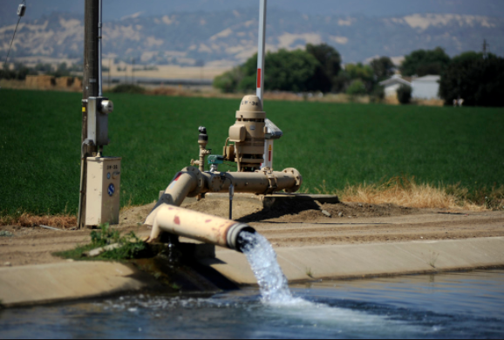
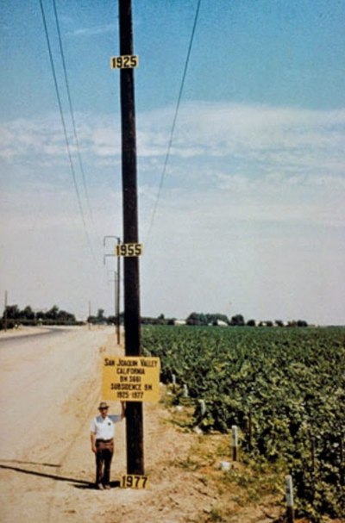
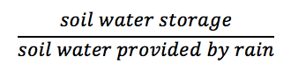
Decoding Streamflow “Fingerprints” in Irrigated Basins
Minghui Zhang; Sally Thompson, PhD
University of California, Berkeley
Human activity disrupts PUB efforts
Irrigation changes streamflow metrics
Irrigation causes water crisis syndromes
“Predictions in ungauged basins” (PUB) traditionally focus on natural basins.
However, including human activity in PUB efforts is essential given the high level of development of many basins.
Percent change in streamflow metrics (α, λ, and average streamflow) serve as fingerprints that differentiate among irrigation sources. Fingerprints vary across catchment type and irrigation source.
Water crisis syndromes of: (1) unsustainability (aquifer depletion), (2) ecological destruction (perturbation of natural streamflow volume), and (3) social impact (irrigation needs unmet) are summed in the following plots.
Two scenarios allow us to eliminate certain source possibilities. Catchments that belong to these scenarios are unlikely to use that source.
Deviations of streamflow from natural conditions provide clues about water management practices in the catchment.
Percent change from natural conditions
Expand PUB methods to irrigated basins
Irrigation is provided without negative impact
1. Exploration
Model streamflow resulting from four separate irrigation sources.
2. Estimation
Relate irrigation regimes back to deviation in natural streamflow.
Percent change in α
Irrigation needs are unfulfilled, but cause water crisis
Irrigation can be sourced from imports, river, and aquifers. Can we differentiate among these sources based on streamflow fingerprints?
Source: Jim Hawthorne Photography
Source: Daily Republic
Conclusion 2:
Presence of water crisis syndromes aid in differentiating irrigation sources.
Modeled streamflow illustrates the fingerprints attributed to four irrigation sources.
Catchments
Model
Periodic irrigation causes “saw-tooth” pattern
Imports increase streamflow magnitude and peak frequency
For arid catchments, river cannot supply irrigation and change in metrics is zero
Three streamflow metrics, α, λ, and average streamflow, describe changes attributable to irrigation.
Conclusion 1:
Contour plots allow us to construct theoretical fingerprints for each source, to be compared to measured fingerprints. These fingerprints differentiate among irrigation sources.
Irrigation is triggered at 60% of field capacity.

